Slide 1
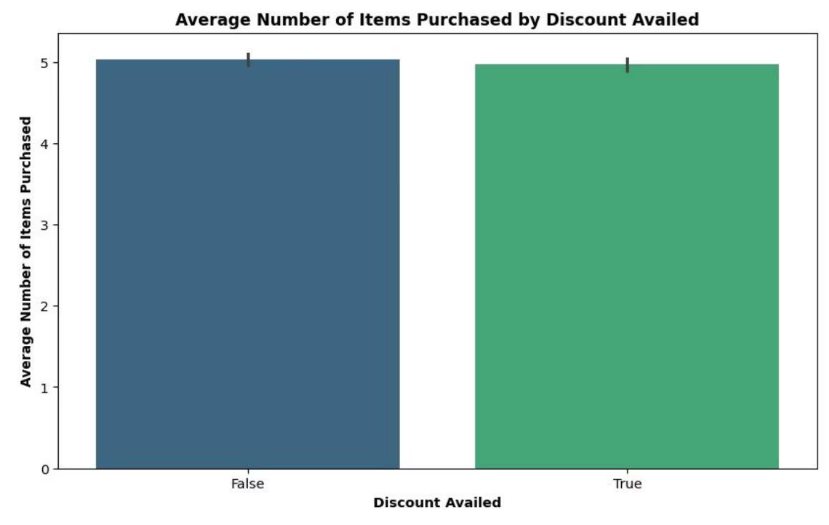
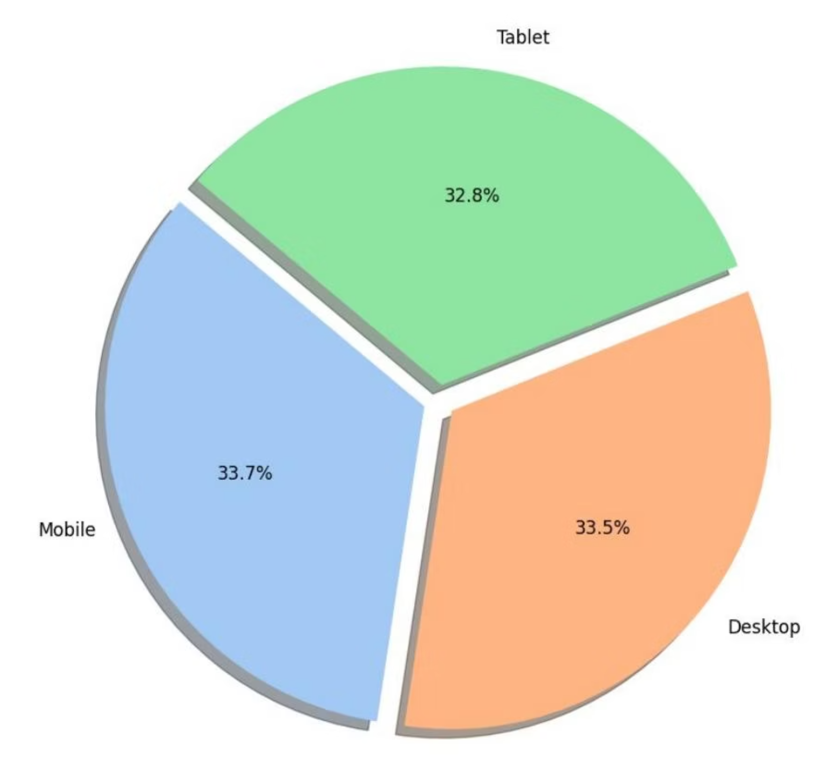
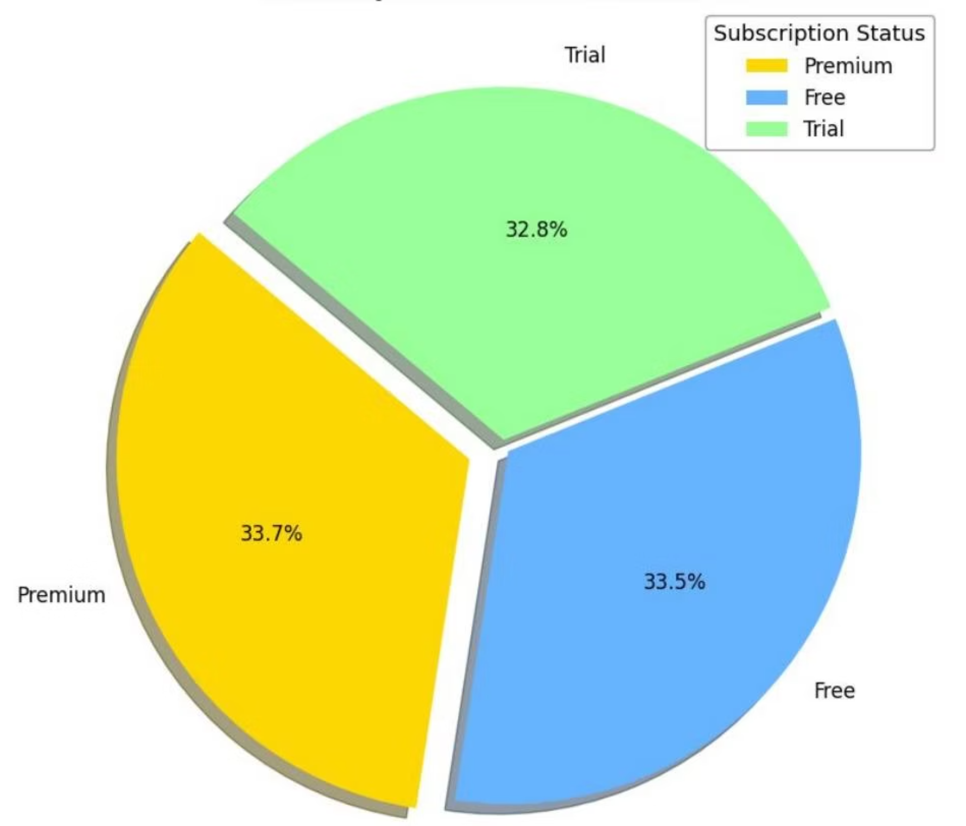
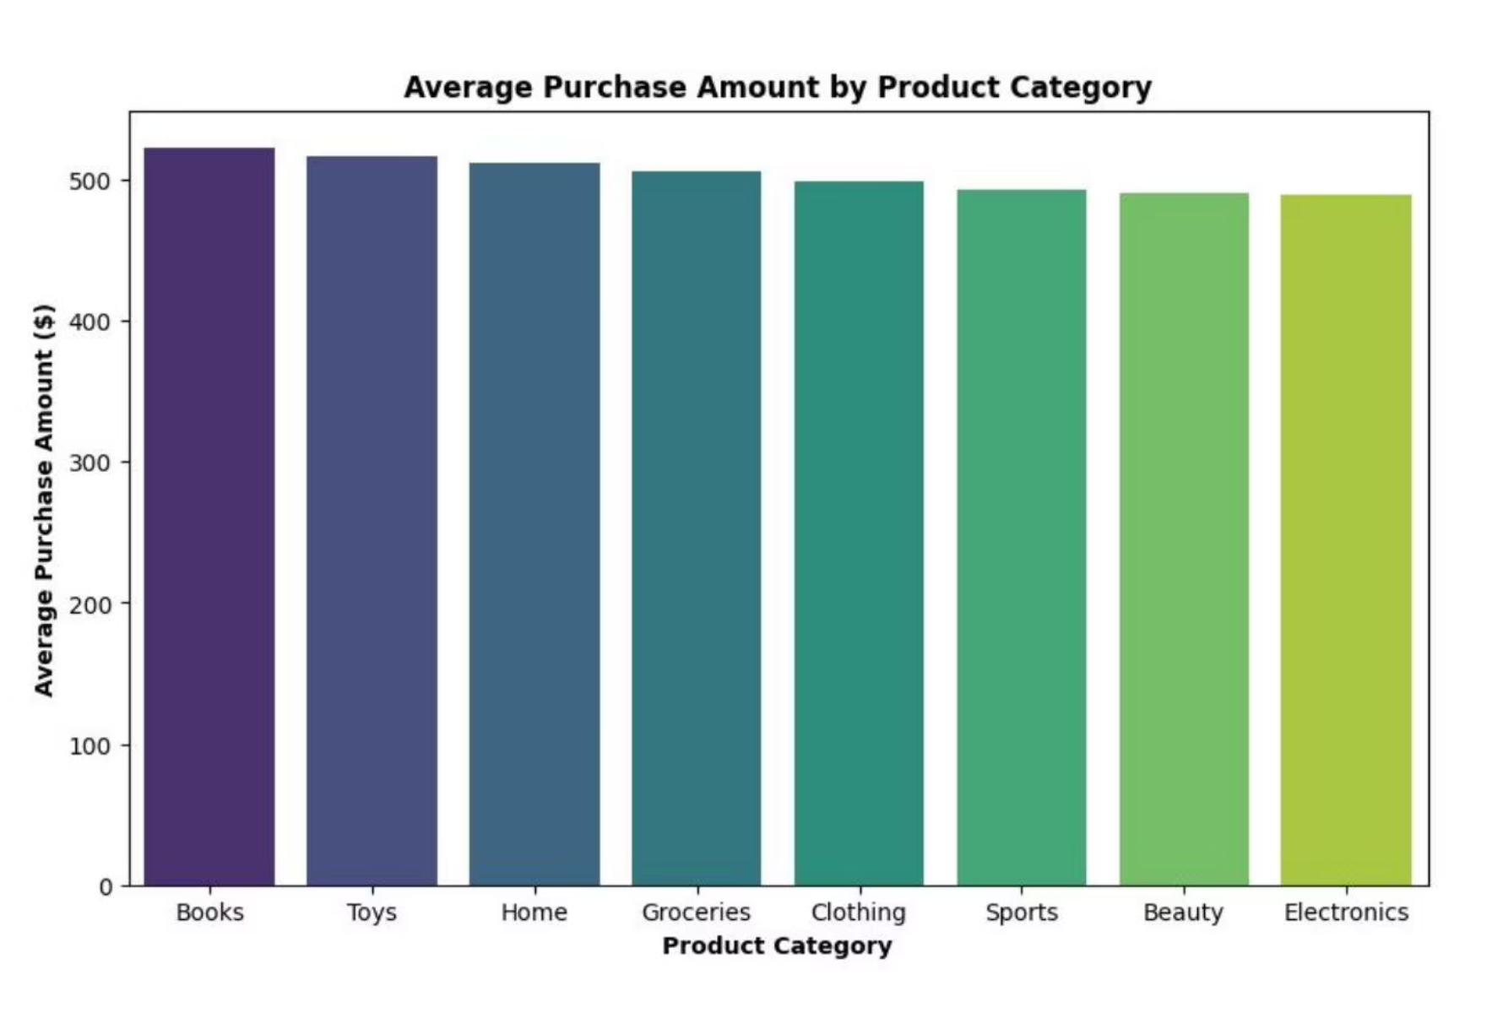
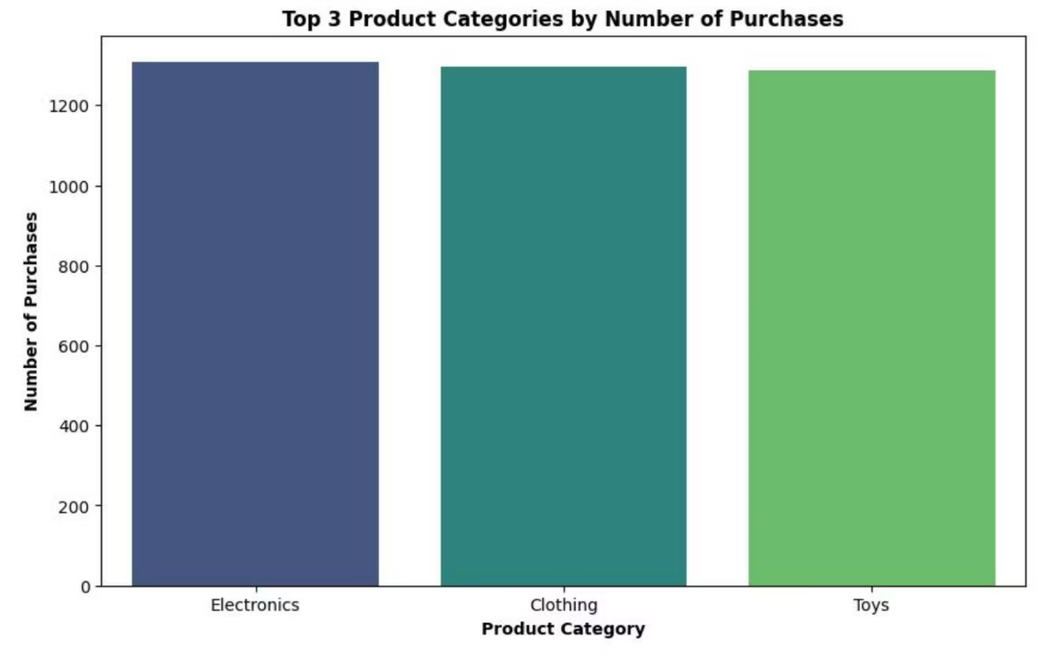
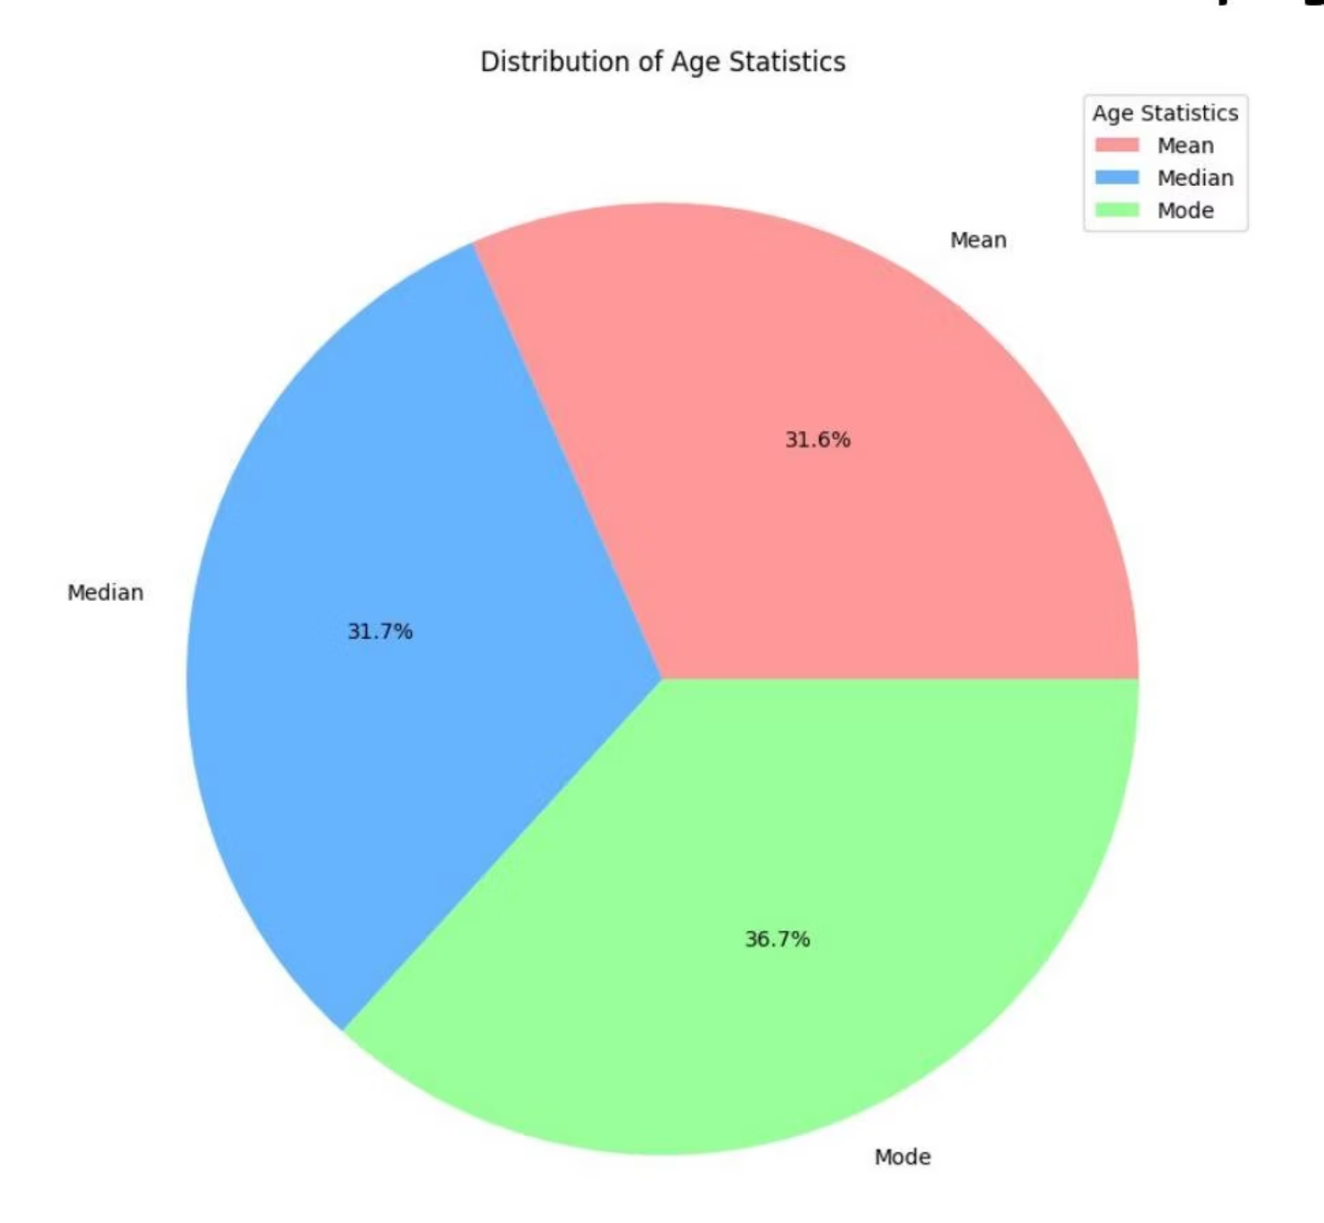
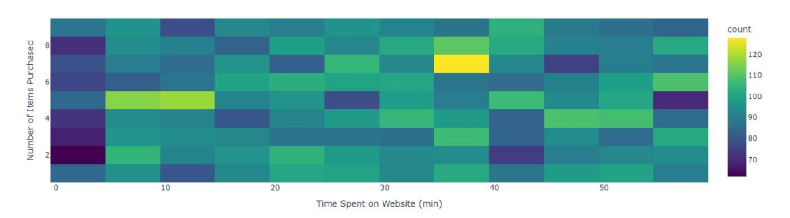
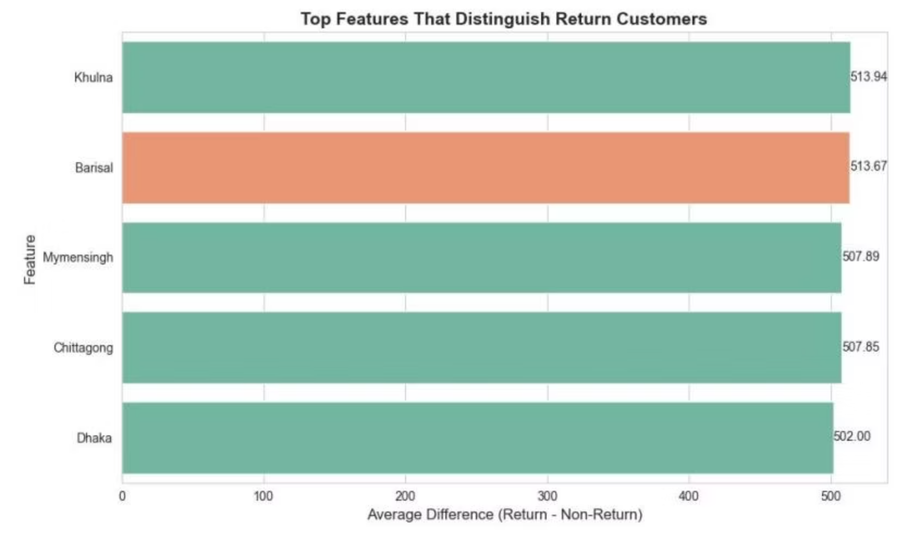
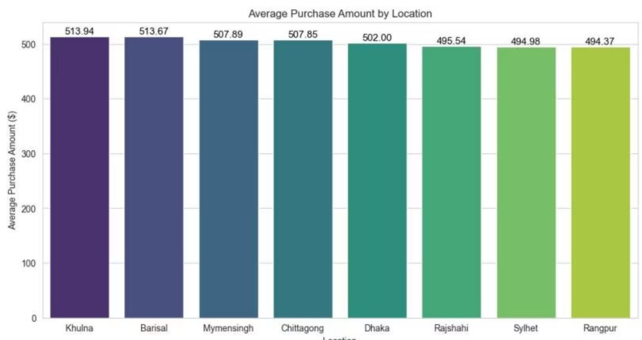
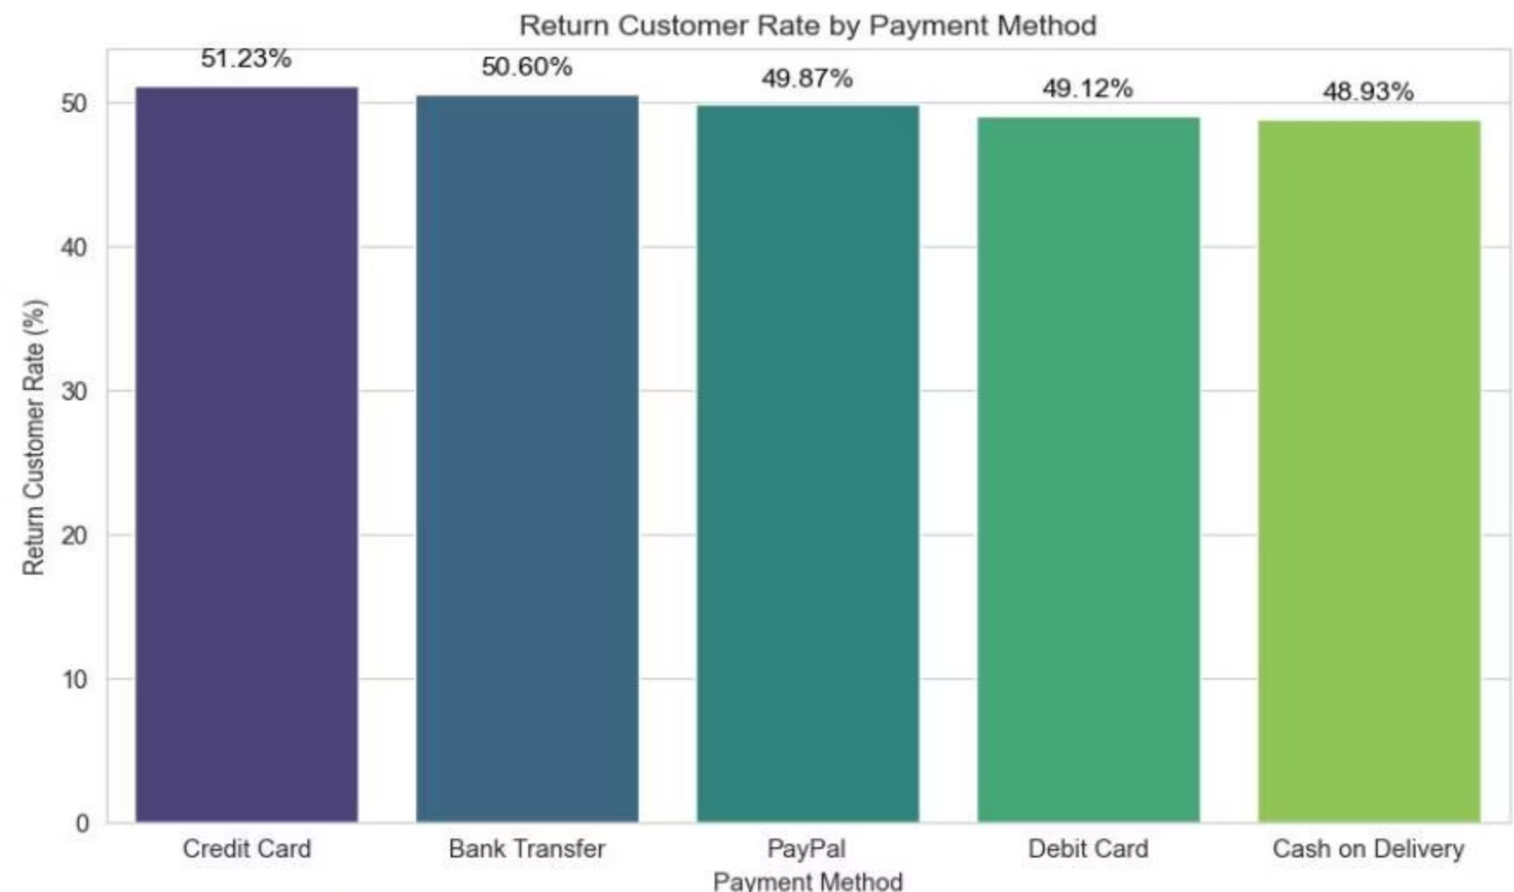
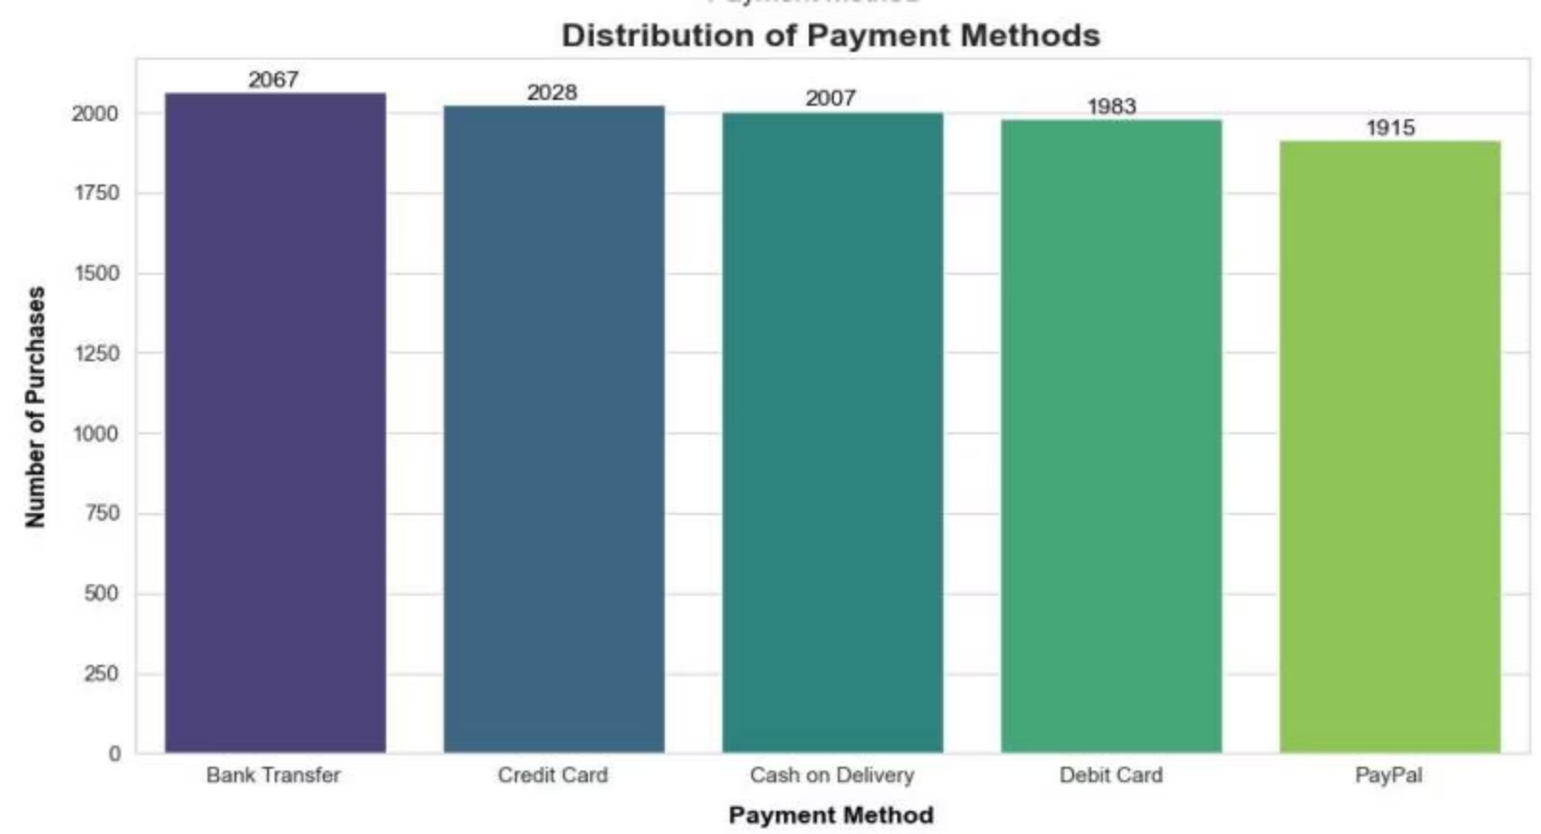
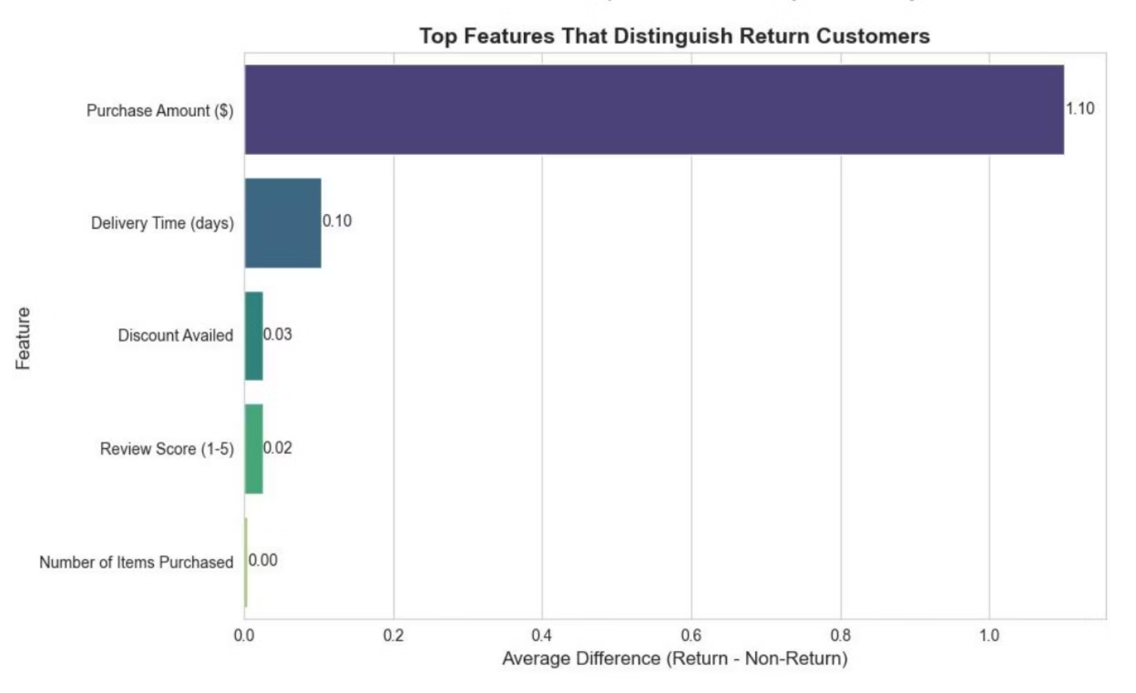
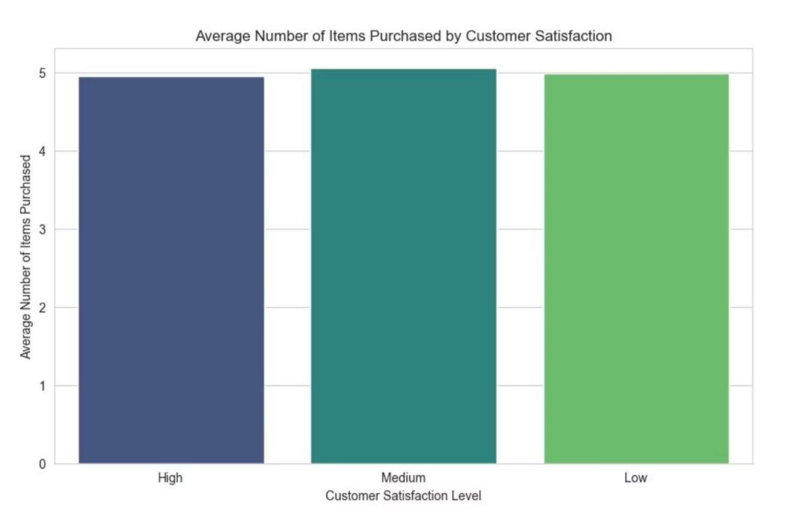
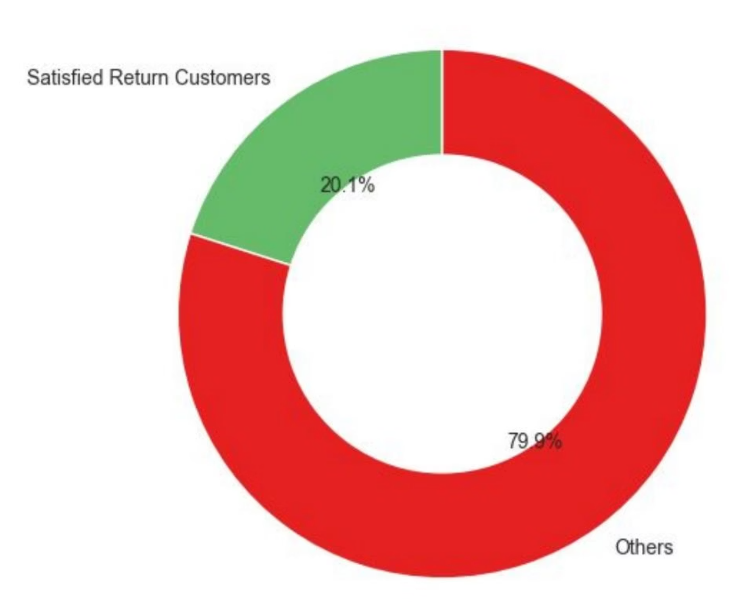


E-commerce Insights
E-Commerce Customer Behavior Analysis
Presented By: Muhammad Omar | Batch: 2504 | Instructor: Tanji Evan
Date: July 30, 2025
Impact of Discounts on Purchase Behavior
Insight:
Users who utilized discounts purchased nearly the same number of items (~5) as those who did not. This suggests that discounts alone are not significantly increasing purchase volume.
Suggestion:
Shift focus from aggressive discounting to enhancing product relevance, quality, and branding to drive higher order quantities.
Device Type Share: A Balanced Approach
Insight:
Purchases are almost evenly distributed across mobile (33.7%), desktop (33.5%), and tablet (32.8%). This indicates a versatile customer base.
Suggestion:
Maintain equally optimized experiences across all platforms (responsive web design, dedicated apps) to cater to this balanced distribution and ensure seamless shopping.
Subscription Status Distribution & Targeting
Insight:
Users are nearly evenly distributed across 'Premium', 'Free', and 'Trial' segments (~33% each).
Suggestion:
Develop customized marketing strategies for each segment to maximize engagement and conversion. For example, encourage Trial users to upgrade to Premium with exclusive offers.
Average Purchase Amount by Product Category
Insight:
Average spending is consistent across categories ($490–$520), with Books having the highest average ($520). This suggests a tendency for bulk or higher-value orders in this category.
Suggestion:
Implement targeted promotions or bundles in the Books category to leverage this purchasing behavior. Consider cross-selling related items or premium editions.
Top Product Categories by Purchases
Insight:
The top 3 selling categories — Electronics, Clothing, and Toys — dominate overall sales, indicating strong consumer demand.
Suggestion:
Prioritize these categories for stock management, promotional efforts, and demand forecasting to capitalize on their high performance.
Age Distribution & Marketing Opportunities
Insight:
The mode (36.7%) is the highest in age distribution, followed by the median (31.7%) and minimum (31.6%). This indicates a concentration of buyers within a specific age range.
Suggestion:
Leverage these insights to target age-specific marketing campaigns and tailor content to resonate with the most active customer demographic.
Time Spent vs. Items Purchased: Unveiling Nuances
Insight:
Moderate time spent on the website (around 35–40 minutes) correlates with the highest number of items purchased. However, there's no strong linear correlation, suggesting other factors influence purchase decisions more directly.
Suggestion:
Investigate these "other factors" through user surveys or A/B testing to understand what truly drives purchase volume beyond browsing time.
Location & Spending Behavior
Insight:
Khulna and Barisal show the highest average purchase amounts ($514). Surprisingly, Dhaka, a major urban center, exhibits lower average purchases ($502), potentially due to price sensitivity or a broader competitive landscape.
Suggestion:
Focus marketing and upselling strategies in Khulna and Barisal. For Dhaka, consider bundle discounts or free delivery thresholds to increase average cart size and combat price sensitivity.
Return Customers by Payment Method & Satisfaction
Insight:
Credit Card users have the highest return rate (51.23%) but the lowest average review scores. Conversely, Cash on Delivery (COD) has the lowest return rate but the highest review score (3.02), indicating higher satisfaction but less loyalty.
Suggestion:
Investigate friction points for credit card users (e.g., UX during checkout, trust issues). Promote COD with loyalty incentives to convert high satisfaction into repeat business.
Key Drivers for Repeat Business
Insight:
Purchase amount is the most influential factor for return customers, followed by delivery time. Discounts, reviews, and the number of items purchased have minimal impact on repeat behavior.
Suggestion:
Address the disparity between return rates and satisfaction. Conduct surveys to identify post-purchase pain points (e.g., shipping delays, product quality mismatches) that could be affecting loyalty.
Customer Satisfaction vs. Quantity Purchased
Insight:
Surprisingly, customers with a medium satisfaction level purchase slightly more than those with high or low satisfaction. This suggests that satisfaction alone does not strictly dictate purchase volume.
Suggestion:
Further research is needed to understand the motivations behind medium-satisfaction buyers and how to convert them into highly satisfied, loyal customers.
Satisfied Return Customers: A Critical Gap
Insight:
Only ~20.1% of return customers report being satisfied. This indicates a significant gap between customer retention and actual satisfaction, suggesting unmet expectations post-purchase.
Suggestion:
Implement robust post-purchase feedback mechanisms and proactive customer support to identify and address issues, improving overall satisfaction among returning patrons.
Key Recommendations for E-Commerce Growth
1
2
Optimize Local Marketing & Upselling
Enhance Post-Purchase Experience
Focus strategies in Khulna and Barisal to leverage high purchase values. Implement bundle discounts or free delivery thresholds to increase average cart size.
Bridge the gap between return rates and satisfaction. Survey return customers to understand and address pain points like shipping delays or product quality mismatches.
3
4
Refine Payment Experience & Loyalty
Streamline Delivery Logistics
Investigate credit card user pain points (UX, trust). Promote Cash on Delivery with loyalty incentives to convert high satisfaction into repeat customers.
Prioritize faster delivery, especially in areas with high returns or where delivery time is a key differentiator. Optimize supply chain for efficiency.
5
6
Targeted Campaigns for Value & Retention
Prioritize Product Quality & Branding
Create tailored ads for high-value regions. Leverage return customer profiles for personalized re-engagement emails and offers.
Shift focus from discounts to product quality, reviews, and branding. Discounts alone aren't driving higher purchase volume, so a holistic approach is needed.
7
8
Ensure Omnichannel Consistency
Strengthen Inventory & Promotions
Maintain equivalent shopping experiences across mobile, desktop, and tablet. All platforms should be equally optimized for seamless user journeys.
Enhance inventory management and promotional efforts for Books and the top three product categories (Electronics, Clothing, Toys) to maximize revenue.
9
10
Personalize Subscription Engagement
Leverage Age-Specific Targeting
Launch personalized offers and messaging based on subscription status (Premium, Free, Trial) to encourage upgrades and maximize conversions.
Utilize age insights to target advertising and content to the most active customer age group, ensuring marketing efforts are highly relevant.

